Slide 1
Transactional Libraries
Alexander Spiegelman*, Guy Golan-Gueta†, and Idit Keidar†*
*Technion †Yahoo Research

Slide 2
Agenda
Motivation
Concurrent Data Structure Libraries (CDSLs) vs Transactional Memory
Introducing: Transactional Data Structure Libraries (TDSL)
Example TDSL algorithm
Skiplist
Composition of multiple objects
Fast abort-free singletons
Library composition
Evaluation

Slide 3
Multi-Threading is Everywhere
Notes:
Multi core machines
Too much data for sequential programs
Many clients
Concurrent is fast

Slide 4
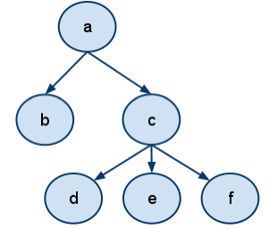
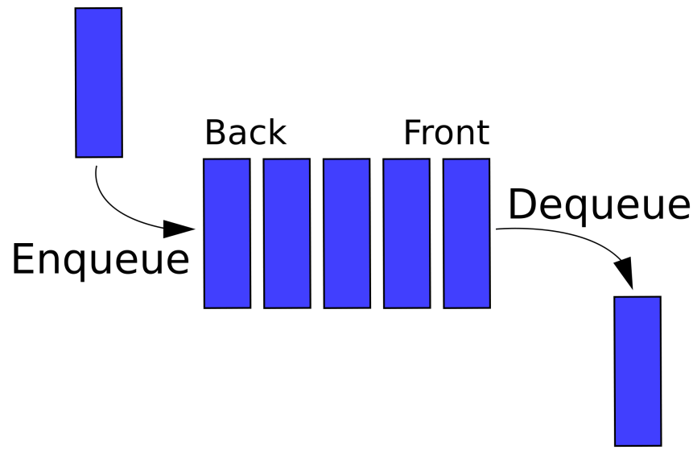
Data Structures (DS)
Essential building blocks in modern SW
Map, skiplist, queue, etc.

Slide 5
But Are They “Thread Safe”?
Correct under concurrency?
OR
?
Notes:
לדוגמא רוצים למנוע שמכניסים שני איברים במקביל ורואים רק אחד

Slide 6
“Thread-Safe” Concurrent DS Libraries
Widely used in real life software
Numerous research papers
Concurrent Skipklist [Herlihy, Lev, Luchangco, Shavit: A simple optimistic skiplist algorithm] [Fraser: Practical lock freedom] …
Concurrent queue [Michael, Scott: Simple, fast, and practical nonblocking and blocking concurrent queue algorithms] [Gramoli, Guerraoui: Reusable concurrent data types]
Concurrent binary tree [Bronson, Casper, Chafi, Olukotun: A practical concurrent binary search tree] [Drachsler, Vechev, Yahav: Practical concurrent binary search trees via logical ordering]
Notes:
API example

Slide 7
Concurrent Data Structure Libraries (CDSLs)
Each operation executes atomically
Custom-tailored implementation preserves semantics
balance←map.get (key=Yoni)
newBalance← balance + deposit
map.set(key=Yoni, newBalance)
repQ.enq(“Yoni’s balance=new”)
App
App
App
map
queue
Notes:
API example

Slide 8
Are They Really Thread Safe??
balance ←map.get (key=Yoni)
balance ←map.get(key=Yoni)
newBalance← balance + deposit
newBalance← balance + deposit
map.set(key=Yoni, newBalance)
map.set(key=Yoni, newBalance)
repQ.enq(“Yoni’s balance=new”)
repQ.enq(“Yoni’s balance=new”)
Oops! Atomic operations are not enough
Notes:
API example

Slide 9
Software Transactional Memory (STM)
TL2, TinySTM, SwissTM,…
Transactions (TXs) = atomic sections including multiple DS operations
Begin_TX balance←map.get(key=Yoni)
newBalance ← balance + deposit
map.set(key=Yoni, newBalance)
repQ.enq(“Yoni’s balance=new”)
End_TX
App
end
map
queue
abort
begin
STM
Notes:
API example
DS does not have to be concurrent.

Slide 10
CDSL vs STM
Why?
 | CDSL | STM
Performance | ✓ | ✗
Exploit DS semantics | ✓ | ✗
Used in practice | ✓ | ✗
Generality | ✗ | ✓
Composability | ✗ | ✓

Slide 11
STM Overhead Explained
Common STM solution:
Each object has a version
TX reads a “consistent snapshot”
Validates versions have not changed by commit time
Otherwise aborts
TX updates occur during commit
Sources of overhead:
Global version clock (GVC) ⇒ high contention
Read- and write-sets ⇒ tracking and validation overhead
Conflicts ⇒ aborts

Slide 12
Agenda
Motivation
Concurrent Data Structure Libraries (CDSLs) vs Transactional Memory
Introducing: Transactional Data Structure Libraries (TDSL)
Example TDSL algorithm
Skiplist
Composition of multiple objects
Fast abort-free singletons
Library composition
Evaluation

Slide 13
TDSL: Bringing Transactions into CDSL
App
App
App
STM programmability: TXs span any number of operations
Legacy “singleton” operations: fast, abort-free
end
abort
begin
Custom-tailored, performance of CDSL
Transactional Library
Missing: Generality of STM
map
queue

Slide 14
Why TDSL?
Power of transactions
Optimizations using DS semantics and structure
Use semantics to reduce overhead aborts
E.g., read-set reduction, non-transactional index
Different CC mechanisms for different DSs
Optimistic maps, sets
Pessimistic queues
Fast abort-free singletons
As fast as in CDSL
No contention on global version clock
Support legacy code
Notes:
Split to titles of next slides

Slide 15
TDSL Benefit 1: Programmability
Support for legacy code
Fast, abort-free singletons
Power of transactions
Begin_TX val←map.get(key=Yoni)
new← val+deposit
map.set(key=Yoni,new)
repQ.enq(“Yoni’s balance=new”)
End_TX
App
App
App
Transactional Library
map
queue

Slide 16
TDSL Benefit 2: Semantic Optimization
Use known transactional solutions
But, take advantage of semantics & structure of each DS to reduce aborts & overhead
Reduce read-set
Do some of the work non-transactionally
Notes:
The idea is to support TXs but avoid unnecessary aborts.

Slide 17
Example of Abort Reduction
Two concurrent put operations
Put(23) traverses the list, reads nodes that put(4) updates
Conflict, STM would abort at least one
But no semantic conflict
4
23
2
5
9
17
34
Notes:
We will see in a few slides that in standard STM one of this operations will abort.

Slide 18
Example of Abort Reduction
Two concurrent put operations
Put(23) traverses the list, reading nodes put(4) updates
Conflict, STM would abort at least one
But no semantic conflict
4
23
2
5
9
17
34
Notes:
For example: linklist
We will see in a few slides that in standard STM one of this operations will abort.

Slide 19
TDSL Benefit 3: Mix & Match
Maps allow lots of concurrency
Amenable to optimistic synchronization
Queues do not
Pessimistic synchronization better
STM picks one
Our TDSL can mix & match
App
App
App
Transactional Library
optimistic map
pessimistic queue
Notes:
The idea is to support TXs but avoid unnecessary aborts.

Slide 20
Agenda
Motivation
Concurrent Data Structure Libraries (CDSLs) vs Transactional Memory
Introducing: Transactional Data Structure Libraries (TDSL)
Example TDSL algorithm
Skiplist
Composition of multiple objects
Fast abort-free singletons
Library composition
Evaluation

Slide 21
Skiplist Roadmap
Add STM-like transaction support to simple linked list
Based on TL2 STM algorithm
Optimization: remove redundant validation and tracking
Use semantics and structure
Optimization: shorten transactions
Non-transactional index
Lazy GC

Slide 22
Step 1: Standard STM
Take a simple linked list
Add TL2 mechanism to support TXs:
Add a version to each node
Get versions from global version clock (GVC)
Maintain read-set with read versions
Defer updates, track in write-set
To commit: validate read-set, lock write-set, increment GCV, update
2
5
9
17
34

Slide 23
Step 1: Standard STM
insert(10):
read-set
write-set
10
2
5
9
9
10
17
Local memory
Read
Shared memory
Validate
GVC
2
5
9
17
34

Slide 24
Step 2: Reduce Read-Set
Exploit structure and semantics
insert(10):
read-set
write-set
10
9
9
10
Local memory
Read
Shared memory
Validate
GVC
2
5
9
17
34

Slide 25
Step 3: Non-Transactional Index
Imagine we could guess the right node
So, we could be faster and save aborts during the traversal
GVC
2
5
9
17
34

Slide 26
Step 3: Non-Transactional Index
getSmaller
Returns some node with a smaller key
For performance, not much smaller
Implemented as (concurrent) skiplist
For example
App
add(n)
remove(n)
getSmaller (key)
Index

Slide 27
Step 3: Non-Transactional Index
insert(10):
App
10
getSmaller(10)
return 5
Start traverse from 5
Index
GVC
2
5
9
17
34
Notes:
After we read the global clock

Slide 28
Step 3: Non-Transactional Index
Updated outside the TX (if completes successfully)
Reduces aborts, overhead
But:
May return nodes with smaller keys than predecessor
⇒ longer traversals
May return removed nodes
Subtle, more details in the paper

Slide 29
Agenda
Motivation
Concurrent Data Structure Libraries (CDSLs) vs Transactional Memory
Introducing: Transactional Data Structure Libraries (TDSL)
Example TDSL algorithm
Skiplist
Composition of multiple objects
Fast abort-free singletons
Library composition
Evaluation

Slide 30
Composition
One GVC shared among all objects
Commit:
Lock all write sets
Validate all read sets
Increase GVC
Update objects and release locks
Notes:
להגיד: מימשנו גם queue.

Slide 31
Agenda
Motivation
Concurrent Data Structure Libraries (CDSLs) vs Transactional Memory
Introducing: Transactional Data Structure Libraries (TDSL)
Example TDSL algorithm
Skiplist
Composition of multiple objects
Fast abort-free singletons
Library composition
Evaluation

Slide 32
Fast Abort-Free Singletons
Use the index
Do not increment GVC
No contention
As fast as in CDSL
Make transactions aware of singletons using designated fields
Details in the paper
Notes:
להזכיר למה זה חשוב לנו. ממה התחלנו בעצם..

Slide 33
Agenda
Motivation
Concurrent Data Structure Libraries (CDSLs) vs Transactional Memory
Introducing: Transactional Data Structure Libraries (TDSL)
Example TDSL algorithm
Skiplist
Composition of multiple objects
Fast abort-free singletons
Library composition
Evaluation

Slide 34
Composing TDSLs
Extend API to support:
TX-begin
Divide TX-commit into three phases: TX-lock, TX-verify, and TX-finalize
TX-abort
Perform TX-begin and each of the commit phase in all libraries
Wait for completion in all libraries before moving to the next phase
If catch abort in some library, perform TX-abort in all
Some semantics have to be satisfied
Based on theory of PLDI’15 paper by Ziv et al. [Ziv, Aiken, Golan-Gueta, Ramalingam, Sagiv. Composing concurrency control]

Slide 35
Compose With Existing Libraries
Modify library to support the above API
E.g., TL2 STM naturally supports it
E.g., use standard 2 phase locking
Some of the phases can be empty
E.g., empty TX-verify in pessimistic two-phase locking
Together we get general transactions
Ones supported fully by a custom-tailored TDSL are fast
Others less so

Slide 36
Agenda
Motivation
Concurrent Data Structure Libraries (CDSLs) vs Transactional Memory
Introducing: Transactional Data Structure Libraries (TDSL)
Example TDSL algorithm
Skiplist
Composition of multiple objects
Fast abort-free singletons
Library composition
Evaluation

Slide 37
Singletons
As good as baseline
our skiplist rotating nohotspot fraser optimistic baseline
Do not support transactions
Notes:
We use synchrobench.

Slide 38
Singletons
Notes:
חשוב לציין שאנחנו בדיוק כמו הbase line. היינו יכולים להחילף את האינדקס בכל אחד מהמימושים האלו.

Slide 39
Transactions
We have less overhead
We have less aborts
our skiplist SeqTL2 FriendlyTL2
Notes:
משויים מול מימוש שמשתמש ב.STM
בזכות חסכון ב overhead.

Slide 40
Transactions
Notes:
משויים מול מימוש שמשתמש ב.STM
בזכות החיסכון ב aborts.

Slide 41
Transactions (Aborts)
our skiplist SeqTL2 FriendlyTL2
Notes:
משויים מול מימוש שמשתמש ב.STM
בזכות החיסכון ב aborts.

Slide 42
Intruder
Testing multiple skiplists and queues in a real application
cannot support intruder
our skiplist SeqTL2 FriendlyTL2

Slide 43
Conclusion
We introduced a new concept for concurrent programing
Composable DSs supporting TX as well as fast singletons
Implemented library with two DSs
Map (based on skiplist) and queue
We hope that the community will adopt this concept
Build and use more such libraries

